Slide 1

A HYBRID WEB-BASED FRAMEWORK FOR UNIVERSITY COURSE TIMETABLING PROBLEM USING EVOLUTIONARY ALGORITHMS
Supervised by:
Dr. Amr S. Ghoneim
June 2026

Slide 2

Outlines:
Introduction and background
Problem definition
Used datasets
The Proposed Memetic Algorithm (MA)
Proposed Hybrid Methods
Multi-Objective UCTP
Cultural Algorithm
System Architecture
Conclusion and Future Work

Slide 3


Scheduling vs. Timetabling:
Introduction and Background
Timetabling:
Scheduling:
Allocates available resources to predefined events.
Subject to various constraints.
Aims to satisfy objectives as effectively as possible.
Ensures availability of:
Personnel
Facilities
Equipment
Allocates resources to tasks across time and space.
Subject to operational constraints.
Focuses on minimizing resource usage or total cost.
Common applications:
Production planning
Employee shift scheduling
Project management

Slide 4
Introduction and Background
Educational Timetabling Problems:
Involves assigning educational events to limited resources while satisfying a set of constraints.
Events may include:
Lectures
Examinations
Meetings
Goal: Create a conflict-free and feasible timetable.

Slide 5
Introduction and Background
Main Categories of Educational Timetabling:
School Timetabling Context
Weekly scheduling of school classes.
Ensures no teacher is assigned to multiple classes at the same time.
Prevents teacher and class conflicts.
Examination Timetabling
Assigns exams to available rooms and time periods.
Avoids student examination clashes.
Ensures efficient use of resources.
University Course Timetabling (UCTP)
Assigns courses, lecturers, students, rooms, and timeslots.
Prevents scheduling conflicts.
Ensures appropriate learning environments.
Considered a complex multi-dimensional optimization problem.

Slide 6
Introduction and Background
Constraint Modeling and Solution Quality:
UCTP is a highly constrained combinatorial optimization problem.
A valid timetable is evaluated using two types of constraints:
Hard Constraints
Soft Constraints
Hard Constraints (Mandatory):
Must be satisfied completely.
Any violation makes the timetable infeasible.
Examples:
Lectures with common students cannot occur simultaneously
Rooms must satisfy capacity and facility requirements.
Two lectures cannot use the same room at the same time.
A faculty member cannot teach multiple lectures simultaneously.
Daily teaching load must not exceed the allowed limit.

Slide 7
Introduction and Background
Constraint Modeling and Solution Quality:
UCTP is a highly constrained combinatorial optimization problem.
A valid timetable is evaluated using two types of constraints:
Hard Constraints
Soft Constraints
Soft Constraints (Quality Preferences)
Improve timetable quality and user satisfaction.
Violations are allowed but should be minimized.
Examples:
Accommodate faculty preferred teaching times.
Distribute lectures evenly throughout the week.
Avoid more than two consecutive lectures without breaks.
Minimize isolated lectures during a day.

Slide 8
Introduction and Background
Evaluating Solution Quality:
Based on the satisfaction of these constraints(hard and soft constraints.), the quality of an algorithmic output is classified into three tiers:
Infeasible Solution: A schedule that fails to satisfy one or more hard constraints.
Feasible Solution: A schedule that successfully satisfies 100% of the hard constraints, regardless of the number of soft constraint violations.
Optimal Solution: A theoretical ideal where a feasible schedule simultaneously achieves zero soft constraint violations.

Slide 9
Introduction and Background
Variants of University Course Timetabling Problems (UCTP):
UCTPs are commonly classified into two main categories based on the rules defined by the International Timetabling Competition (ITC).
1. Curriculum-Based Course Timetabling (CBCTP):
Conflicts are determined by the predefined university curriculum.
Scheduling is based on curriculum requirements rather than individual student choices.
2. Post Enrolment-Based Course Timetabling (PECTP):
Timetable is generated after student enrollment using actual course selections.
Ensures conflict-free schedules for students, making it more realistic and complex.

Slide 10
Problem Definition
University Course Timetabling Problem (UCTP):
Assign events (lectures/courses) to available timeslots and rooms.
Allocate resources such as students and classrooms without conflicts.
Generate a valid and efficient timetable.
Objective:
Satisfy all hard constraints.
Minimize soft constraint violations.
Produce a high-quality timetable.
Solution Types:
Feasible Solution: Satisfies all hard constraints.
Optimal Solution: Feasible solution with minimal or zero soft constraint violations.

Slide 11
Problem Definition
Constraints:
Hard Constraints (Must Be Satisfied)
H1: Students cannot attend multiple events simultaneously.
H2: Assigned room must satisfy capacity and feature requirements.
H3: Only one event can occupy a room at a given timeslot.
Soft Constraints (Preferred)
S1: Avoid scheduling events in the last timeslot of the day.
S2: Avoid more than two consecutive events.
S3: Avoid having only one event in a day.

Slide 12
Problem Definition
Problem Components:
Main Sets:
Events (E): Courses or lectures.
Timeslots (T): 45 timeslots (9 hours × 5 days).
Rooms (R): Available classrooms.
Students (S): Students attending events.
Features (F): Room facilities required by events.
Goal:
Assign each event to:
A suitable room.
A suitable timeslot.
While satisfying all constraints.

Slide 13
Problem Definition
Data Representation:
Core Matrices:
Student–Event Matrix (A)
Indicates which students attend each event.
Event–Conflict Matrix (B)
Identifies events that cannot occur simultaneously.
Room–Features Matrix (C)
Describes facilities available in each room.
Event–Features Matrix (D)
Specifies facilities required by each event.
Event–Room Matrix (G)
Lists all suitable rooms for each event.
Solution Representation:
Each event is assigned a (Room, Timeslot) pair.
Empty room-timeslot pairs are represented by -1.

Slide 14
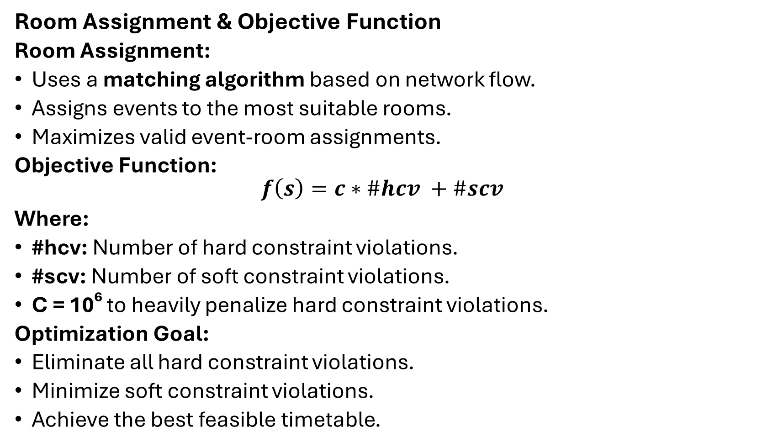
Problem Definition
Room Assignment & Objective Function
Room Assignment:
Uses a matching algorithm based on network flow.
Assigns events to the most suitable rooms.
Maximizes valid event-room assignments.
Objective Function:
$$f\left(s\right)=c∗\#hcv +\#scv$$
Where:
#hcv: Number of hard constraint violations.
#scv: Number of soft constraint violations.
C = 10⁶ to heavily penalize hard constraint violations.
Optimization Goal:
Eliminate all hard constraint violations.
Minimize soft constraint violations.
Achieve the best feasible timetable.

Slide 15
Problem Definition
Formulation of the Post Enrolment-Based Course Timetabling Problem (PECTP):
PECTP is defined as assigning events (lectures/courses) to timeslots and rooms while satisfying strict constraints derived from real student enrollment data.
Hard Constraints:
H1: A student cannot attend more than one event at the same time.
H2: Rooms must have sufficient capacity and required features for each event.
H3: Only one event can be assigned to a room in a given timeslot.
H4: Events can only be scheduled in predefined available timeslots.
H5: Events must follow required ordering/precedence constraints.

Slide 16
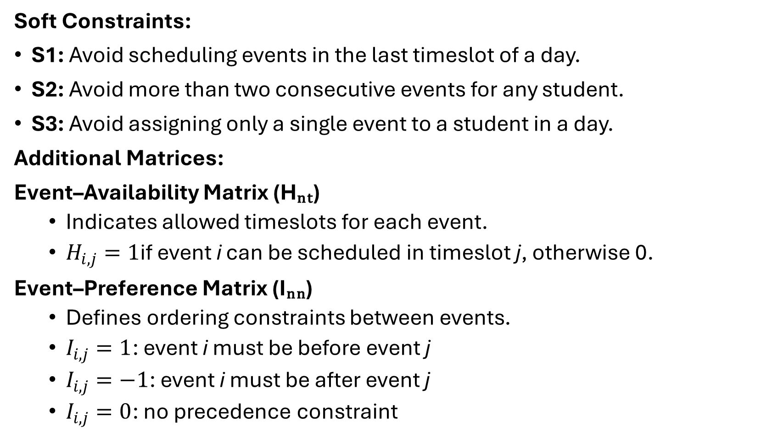
Problem Definition
Soft Constraints:
S1: Avoid scheduling events in the last timeslot of a day.
S2: Avoid more than two consecutive events for any student.
S3: Avoid assigning only a single event to a student in a day.
Additional Matrices:
Event–Availability Matrix (Hₙₜ)
Indicates allowed timeslots for each event.
$H_{i,j}=1$if event i can be scheduled in timeslot j, otherwise 0.
Event–Preference Matrix (Iₙₙ)
Defines ordering constraints between events.
$I_{i,j}=1$: event i must be before event j
$I_{i,j}=−1$: event i must be after event j
$I_{i,j}=0$: no precedence constraint

Slide 17
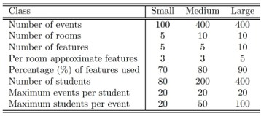
Used Datasets
ITC-2002:
We need to schedule 100-400 events/courses into 45 timeslots, corresponding to 5 days of 9 hours each day. By assigning events, we have to satisfy room constraints and student constraints. These eleven problem instances are divided into three groups: five small instances, five medium instances, and one large instance. In the experimental studies to be carried out in the following chapters on this dataset, we use “S1” to “S5” to represent small instance 1 to small instance 5, respectively, “M1” to “M5” to represent medium instance 1 to medium instance 5, respectively, and “L” to represent the large instance.

Slide 18
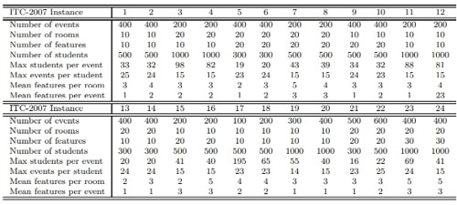
Used Datasets
ITC-2007:

Slide 19
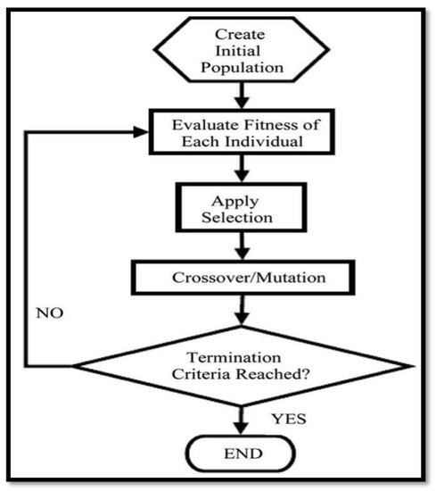



The Proposed Memetic Algorithm (MA)
Memetic Algorithms (MA) integrate population-based global search with individual local refinement. Our framework utilizes a Steady-State Genetic Algorithm (SSGA) model:
SSGA Model: Overlapping population ensures stability and diversity.
Local Refinement: LS1 and LS2 are applied to every child for intensification.
Performance: Zero-allocation C++ engine for maximum speed.

Slide 20



Advanced Neighborhood Search
N1: Displacement
N2: Pairwise Swap
N3: 3-Cycle
Moves exactly one event from its current timeslot to a different, more favorable timeslot.
Exchanges the timeslots of two distinct events to resolve complex student overlaps.
Permutes three events across distinct slots to escape deep local optima in the fitness landscape.
O(|E| × |T|)
O(|E|²)
O(|E|³)

Slide 21
Bipartite Room Allocation
Room allocation is treated as a Maximum Cardinality Bipartite Matching problem.
Partition U: Events in timeslot t_{j}
Partition V: Available Rooms R
Edges E: Suitability (Capacity & Features)

Slide 22
Network Flow Transformation
Construction Phase
Ford-Fulkerson Logic
Introducing artificial nodes for algorithm resolution:
Resolved using the Max-Flow Min-Cut theorem:
Super-Source (s): Connects to all event nodes.
Determines maximum possible placements.
Super-Sink (t): Connects from all room nodes.
Iterative augmenting paths discovery.
Guarantees deterministic optimal matching.
Capacity: Uniformly set to 1 for all edges.

Slide 23
Network Flow Transformation
What if during the early, highly stochastic exploratory
phases of a metaheuristic where the temporal timeslot assignment might be
disastrously suboptimal. In these instances, events are left unplaced because there are
simply no remaining valid rooms, or because the metaheuristic has scheduled far too
many events in a single timeslot.
?
Thinking Time
If an algorithm leaves events unassigned, the timetable is incomplete, making objective fitness evaluation impossible. To resolve this, Rossi-Doria et al. implemented a strict, uncompromising deterministic fallback protocol to handle overflow events

Slide 24
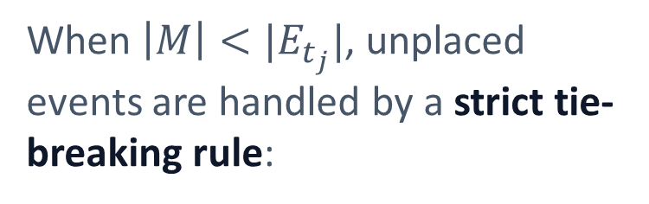
Deterministic Fallback
Handling Overflow Events
|M|
When $\left|M\right|<|E_{t_{j}}|$, unplaced events are handled by a strict tie-breaking rule:
Matching Cardinality
Events are processed in Label Order.
Forced into rooms despite capacity/conflict violations.
Ensures a fully defined (though illegal) timetable for evaluation.

Slide 25
Local Search 1: Constraint Tuning
Step 1: Hard Constraints
Step 2: Soft Constraints
Systematically iterates through infeasible events. Applies N1, N2, then N3 until violations are reduced or s_{max} is reached.
Executed only after reaching a feasible solution. Refines quality without violating established hard constraints.
Delta-Evaluation: Room-allocation disturbance is resolved via the Matching Algorithm after every single move in the loop.

Slide 26
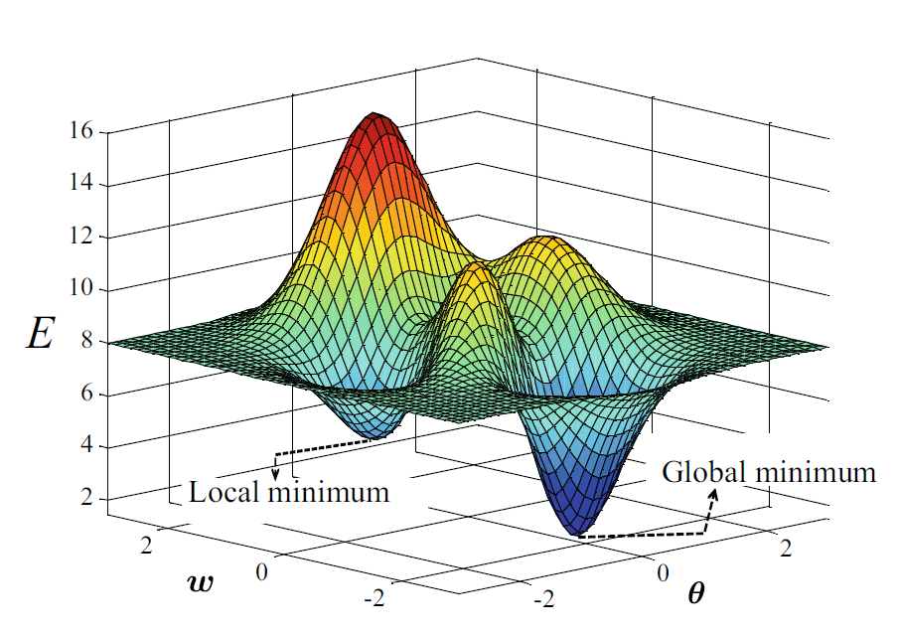
LS2: Stochastic Targeting
Worst-Slot Improvement
LS2 focuses computational power on specific bottlenecks:
Randomly selects a subset (tp%) of timeslots.
Identifies the worst-performing slot (wt).
Attempts N1 moves for every event in wt.
Moves are applied only if the aggregate penalty decreases.

Slide 27
Steady-State GA Architecture
Feature | Standard GGA | Steady-State GA (SSGA)
Replacement | Mass extinction / Generational | Worst-member replacement (incremental)
Diversity | High risk of convergence | Highly stable genetic reservoir
Eval. Cost | High (Full population) | Low (Single offspring per cycle)
Best Score | Can regress | Monotonically decreasing (Elitist)

Slide 28
The Memetic Integration Loop
Init
Refine
Evolve
Replace
Randomly initialize population and rooms.
Apply LS1 & LS2 to initial population.
Binary Tournament, X-over (Pc = 0.8), Mutation (Pm = 0.5).
Improve child via LS and inject into SSGA pool.

Slide 29
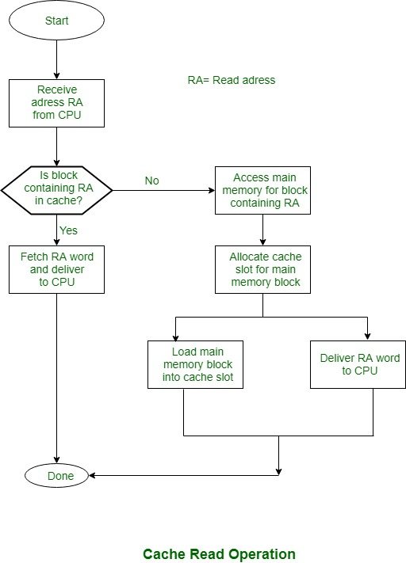


Performance Enhancements
Zero-Allocation Design
Contiguous int16_t arrays maximize CPU cache hit rates, avoiding garbage collection overhead.
Delta Evaluation
Computes localized impact of moves in constant time, bypassing heavy bipartite math for 99% of explorations.

Slide 30
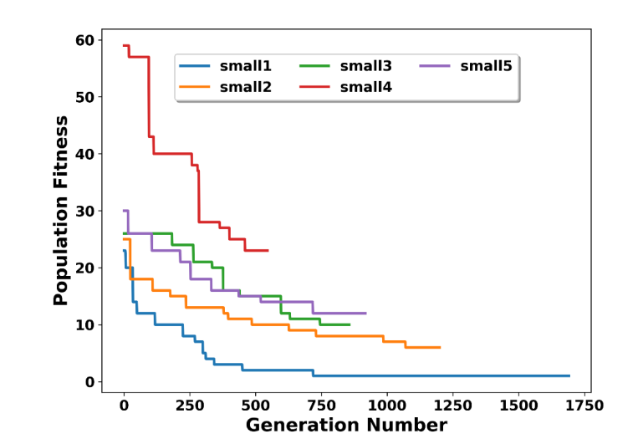
Memetic Evaluation Results
Instance | Best | Worst | Mean
S1 | 0 | 9 | 4.46667
S2 | 4 | 12 | 8.8333
S3 | 11 | 21 | 15.6667
S4 | 21 | 38 | 30.1
S5 | 13 | 20 | 16.1
M1 | 17 | 25 | 20.3
M2 | 21 | 31 | 28.932
M3 | 19 | 23 | 17.1
M4 | 25 | 40 | 33.2
M5 | 23 | 38 | 29.1
comp-2007-2-1.tim | 32002498 | 32002498 | 3.20025e+07

Slide 31
Proposed Hybrid Methods
Post Enrollment Course Timetable Problem(PECTP):
CBCTP
Conflicts are curriculum-based.
Students are grouped into predefined curricula.
Conflict matrix is relatively stable.
Simpler search space.
PECTP
Based on actual student enrollments.
Every student may have a unique event combination.
Dynamic conflict generation.
Additional constraints:
Event Availability (H4)
Event Precedence (H5)
Impact
Larger Search Space
More Constraints
Higher Complexity
Then
Need for a Stronger Hybrid Approach

Slide 32
Proposed Hybrid Methods
HGATS: Hybrid Guided Search Genetic Algorithm with Tabu Search
HGATS = GSGA + TS
Designed for the Post-Enrolment Course Timetabling Problem (PECTP).
Combines global exploration and local exploitation.
Integrates:
Guided Search Genetic Algorithm (GSGA)
Local Search (LS3 & LS4)
Tabu Search (TS)
Objective:
Minimize hard constraint violations.
Minimize soft constraint penalties.
Generate high-quality feasible timetables.

Slide 33
Proposed Hybrid Methods
HGATS Framework
Initialize Population
GSGA
Guided Search /Biased Crossover
Mutation
LS3 + LS4
Best Solution
Tabu Search
Final Solution

Slide 34
Proposed Hybrid Methods
Phase I: GSGA
Guided Search Genetic Algorithm
Main Components
Population Initialization
Guided Search
Biased Crossover
Mutation
Local Search (LS3 & LS4)
Objective
Generate increasingly better timetables while reducing:
Hard Constraint Violations
Soft Constraint Penalties

Slide 35
Proposed Hybrid Methods
Memory Structure (MEM)
Population
Select Top α%
Evaluate Events
Store Good Assignments
MEM
Purpose
Extract useful information from elite solutions.
Store successful (Room, Timeslot) assignments.
Reuse previous knowledge during offspring generation.

Slide 36
Proposed Hybrid Methods
Guided Search Mechanism
Select Base Individual
Choose β × E0 Events
Retrieve Assignments from MEM
Assign Remaining Events
Generate Child
Advantages
Faster convergence.
Better solution quality.
Reduces random exploration.

Slide 37
Proposed Hybrid Methods
Local Search Strategies
1. LS3: Feasibility Improvement
Neighborhood Structures
N1: Move Event
N2: Swap Events
N3: Three-Way Rotation
N4: Random Reassignment
Goal
Repair hard constraint violations and improve feasibility.

Slide 38
Proposed Hybrid Methods
Local Search Strategies
2. Advanced Local Search (LS4)
Additional Neighborhoods
N5 – Precedence Repair :Fix violations of event ordering constraints.
N6 – Worst Timeslot Improvement :Identify problematic timeslots and relocate events.
Benefit
Further reduces timetable penalties after LS3.

Slide 39
Proposed Hybrid Methods
Hybrid Room Assignment Strategy
Room Assignment Process
Step 1: Greedy First-Fit Assignment
Fast room allocation.
Assign first feasible room.
Step 2: Maximum Bipartite Matching
Applied when greedy assignment fails.
Maximizes feasible room-event assignments.
Events ←→ Rooms

Slide 40
Proposed Hybrid Methods
Phase II: Tabu Search
Purpose
Improve the best solution obtained from GSGA.
Neighborhoods Used
N1: Move Event
N2: Swap Events
N4: Diversification Move
Benefits
Intensive local optimization.
Better soft constraint reduction.
Escapes local optima.

Slide 41
Proposed Hybrid Methods
Tabu Search Mechanism
Tabu List
Prevents cycling by temporarily forbidding recently visited moves.
Result
More effective exploration of promising regions.
Current Solution
Generate Neighbors
Evaluate Fitness
Best Non-Tabu Move
Update Tabu List
Repeat

Slide 42
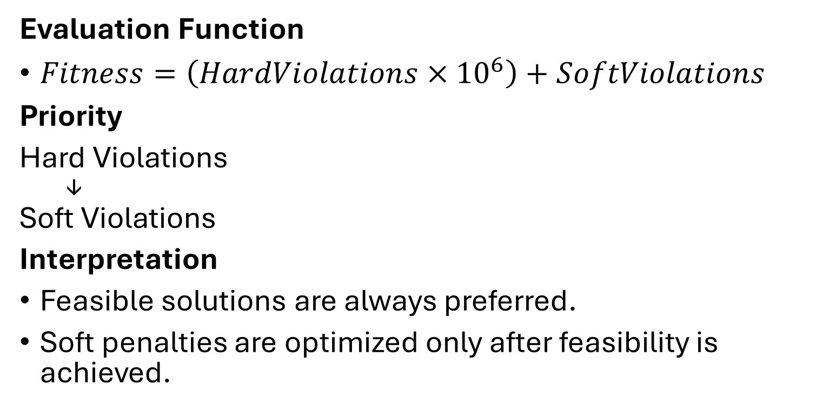
Proposed Hybrid Methods
Fitness Evaluation
Evaluation Function
$Fitness=\left(HardViolations×{10}^{6}\right)+SoftViolations$
Priority
Hard Violations ↓ Soft Violations
Interpretation
Feasible solutions are always preferred.
Soft penalties are optimized only after feasibility is achieved.

Slide 43
Proposed Hybrid Methods
Result on 10 instance and 20 independent runs for ITC-2007
Instance | Best DF | Avg DF | Best SCP | Avg SCP | Best Fitness
comp-2007-2-1 | 0 | 2 | 2563 | 2650.9 | 2563
comp-2007-2-2 | 1 | 6.1 | 0 | 0 | 1000000
comp-2007-2-3 | 0 | 0 | 1209 | 1542.75 | 1209
comp-2007-2-4 | 0 | 0 | 1653 | 1944.15 | 1653
comp-2007-2-5 | 0 | 0 | 1105 | 1315.7 | 1105
comp-2007-2-6 | 0 | 0 | 1026 | 1200.8 | 1026
comp-2007-2-7 | 0 | 0 | 523 | 737 | 523
comp-2007-2-8 | 0 | 0 | 905 | 980.95 | 905
comp-2007-2-9 | 1 | 5.7 | 0 | 0 | 1000000
comp-2007-2-10 | 4 | 10.65 | 0 | 0 | 4000000

Slide 44
Proposed Hybrid Methods
Advantages of HGATS
Exploration
Guided Search
Biased Crossover
Mutation
Exploitation
Local Search (LS3 & LS4)
Tabu Search
Overall Benefits
✓ Better feasibility
✓ Lower soft penalties
✓ Faster convergence
✓ Higher-quality timetables

Slide 45
Multi-Objective UCTP
From Single-Objective UCTP to Multi-Objective UCTP
Single-Objective Approach
Combines all constraints into one fitness value.
Produces a single "best" timetable.
Multi-Objective Approach
Optimizes multiple objectives simultaneously.
Produces a set of Pareto solutions.

Slide 46
Multi-Objective UCTP
Local Search Strategy 5 (LS5)
LS5 follows the same procedure as LS1 but introduces an additional neighborhood structure to enhance exploration of the search space.
N7: Consecutive Event Swap
Select two consecutive events.
Swap their time slots with another pair of consecutive events.
Explore larger search-space movements.

Slide 47
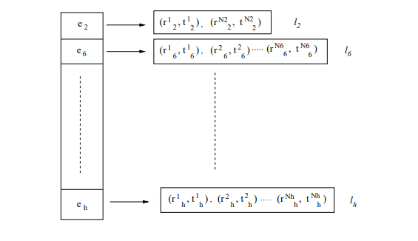
Multi-Objective UCTP
Construction of MEM Structures:
Population P
Every τ generations, memories are rebuilt.
Select the top α × N individuals.
For each objective:
Find events with zero penalty.
Store their room/time-slot assignments.
Build objective-specific memories (MEM₁, MEM₂, MEM₃).
Select α × N Best Individuals
Check Objective Values
Identify Zero-Penalty Events
Store Event Assignments
MEM₁ MEM₂ MEM₃

Slide 48
Multi-Objective UCTP
Guided Search Child Generation:
Select MEMj
Randomly select one memory structure (MEM₁, MEM₂, or MEM₃).
Select β × n events.
For each selected event:
Retrieve a stored high-quality (Room, Time Slot) pair.
Assign it to the offspring.
Randomly assign the remaining events.
Produce a complete child solution.
Select β × n Events
Retrieve Good
(Room, Time Slot)
Assignments
Generate Partial Child
Randomly Assign
Remaining Events
Complete Child

Slide 49
Multi-Objective UCTP
Objective Functions:
The MOUCTP is formulated as a Multi-Objective Optimization Problem (MOOP).
The algorithm simultaneously minimizes:
Objective 1: Avoid scheduling events in the last timeslot of a day.
Objective 2: Avoid more than two consecutive events for any student.
Objective 3: Avoid assigning only a single event to a student in a day.
while satisfying all Hard Constraints.

Slide 50
Multi-Objective UCTP
Constraint Handling (NSGA-II Rule)
When comparing two solutions, the algorithm follows the Constraint-Dominance Principle:
Case 1:Feasible vs. Infeasible
Feasible solution is always preferred.
Case 2:Both Feasible
Use Pareto Dominance.
Case 3:Both Infeasible
Choose the solution with fewer constraint violations.

Slide 51
Multi-Objective UCTP
NSGA-II Ranking & Crowding Distance
Unlike a normal GA that searches for one best solution, NSGA-II searches for a set of Pareto solutions.
Solution | f₁ | f₂ | f₃
A | 2 | 3 | 4
B | 3 | 2 | 5
C | 4 | 4 | 2
D | 5 | 5 | 5
E | 1 | 6 | 3
Front 1 (Rank 1):
A->B->C->E
Front 2 (Rank 2):
D
Crowding Distance
crowding distance is used to keep the most diverse solutions and maintain a well-distributed Pareto front.
Higher crowding distance means higher isolation and better diversity.

Slide 52
Multi-Objective UCTP
Mutation:
Purpose: Introduce diversity and avoid premature convergence.
Process
Apply a random move using one of the neighborhood structures:
N1
N2
N3
N7

Slide 53
Multi-Objective UCTP
Guided Search Non-dominated Sorting Genetic Algorithm (GSNSGA):
Initialize Population
Apply LS5 + LS2
Evaluate Objectives
NSGA-II Ranking & Crowding Distance
Repeat Until Stop
Evaluate Offspring
Apply LS5 + LS2 to Offspring
Mutation (N1 / N2 / N3 / N7)
Generate Offspring
Guided Search
Build MEM₁, MEM₂, MEM₃
Termination Reached?
No → Loop back to Repeat
Yes → Output Pareto Set
Output Non-Dominated (Pareto) Solutions
Merge Parent & Offspring Populations
Select Next Generation Using NSGA-II

Slide 54
Multi-Objective UCTP
Output Non-Dominated (Pareto) Solutions
What does the algorithm return?
Instead of returning a single timetable, GSNSGA-II returns a set of high-quality timetables known as the Pareto Set.
Each timetable represents a different trade-off between the objectives.
Solution | f₁ | f₂ | f₃
A | 10 | 5 | 20
B | 12 | 3 | 15
C | 7 | 8 | 18
Why is this useful?
Instead of forcing one "best" timetable, the algorithm provides several alternatives:
Avoid scheduling events in the last timeslot of a day.
Avoid more than two consecutive events for any student.
Avoid assigning only a single event to a student in a day.
The decision-maker can then choose the timetable that best matches their priorities.
None of these solutions dominates the others:
A has a better f₂ than C.
C has a better f₁ than A.
B has a better f₂ and f₃ than A.

Slide 55
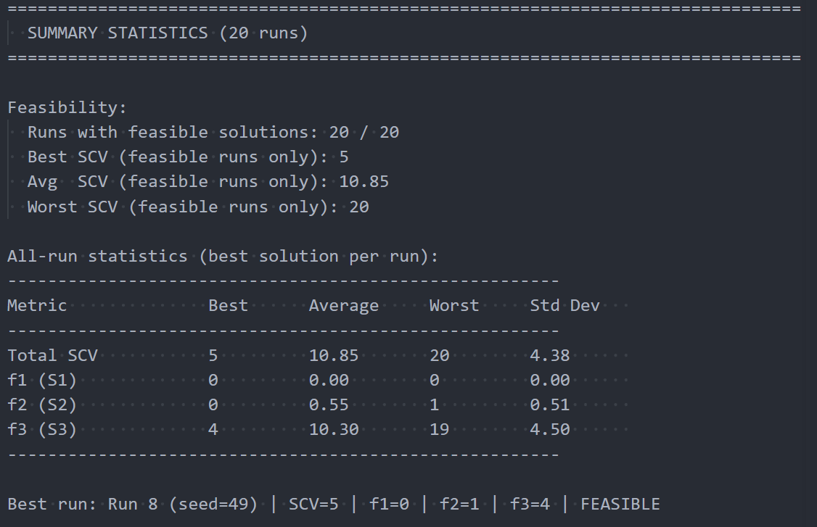
Multi-Objective UCTP
Results:
Results on Small Instances:
Time/run: 100 seconds
s_max: 300
Population: 48
Gamma (GS%): 0.6
Pm (mutate): 0.6
Tau: 20
Base seed: 42
Runs: 20
Problem loaded:
Events (n) = 100
Rooms (m) = 5
Features (l) = 5
Students (k) = 80
TimeSlots (p) = 45
Feasible event-room pairs = 409

Slide 56
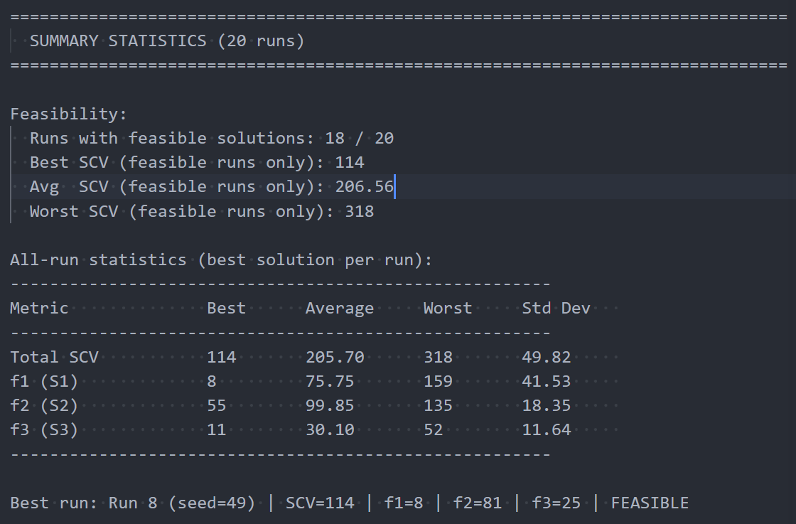
Multi-Objective UCTP
Results:
Results on Medium Instances
Time/run:1000 seconds
s_max: 1500
Population: 48
Gamma (GS%): 0.6
Pm (mutate): 0.6
Tau: 20
Base seed: 42
Runs: 20
Problem loaded:
Events (n) = 400
Rooms (m) = 10
Features (l) = 5
Students (k) = 200
TimeSlots (p) = 45
Feasible event-room pairs = 1623

Slide 57
Cultural Algorithm(CA)
Cultural Algorithm: Evolutionary algorithm that use domain knowledge extracted during the evolutionary process in order to improve the per performance of the search engine.
It can be seen as an inheritance process operating at two levels:
(1) a micro-evolutionary level
(2) a macro-evolutionary level

Slide 58
Cultural Algorithm
(1) a micro-evolutionary level:
consists of the genetic material that an offspring inherits from its parents.
(2) a macro-evolutionary level:
consists of the knowledge acquired by individuals through generations.
This knowledge, once encoded and stored in the belief space, is used to guide the behavior of the individuals that belong to a certain population.

Slide 59


Cultural algorithm:
-Main components:
population space
Communication link
Belief space
(Main difference)

Slide 60
Cultural Algorithm
(Proposed approach)
1. Population space:(traditional evolutionary algorithm)
which consists of (as in all evolutionary algorithms) a set of individuals. Each individual has a set of independent features that are used to determine its fitness.
2. Communication link:
In order to join the two spaces, it is necessary to provide a communication link, which dictates the rules regarding the type of information that must be exchanged between the two spaces.

Slide 61
Cultural Algorithm
(Proposed approach)
(2) Communication link:
Consisting of :
Accept function: At each generation the belief space is updated and it incorporates the individual experiences of a select group of members of the population by applying an accept function.
Influence function: This function applies some pressure such that the children resulting from the variation operators can exibit behaviors closer to the diserable ones and father away from the undiserable ones, according to the information stored in the belief space.

Slide 62
Cultural Algorithm
(Proposed approach)
(3)Belief space:
We have three types of knowledge are stored:
1. Situational: With the situational influence each individual tries to follow a leader. Such a leader is the best individual found, and is stored in the situational belief space
3. Normative: A statistical component that collects the "collective wisdom" of the entire elite population to establish guidelines, boundaries, and safe zones for the mutation process.
3. Domain: makes a post-processing procedure which uses the domain knowledge to modify individuals. In the timetabling problem, it is known that the best solution does not include events in the last timeslots of each day

Slide 63
Cultural Algorithm
(Proposed approach)
(3)Belief space:
Also, we are using five variation operators:
Two of them use the cultural knowledge (cultural mutation and repair).
The other three are designed to add the Exploration component of the algorithm (inter change, sequencing and simple mutation).And there is only one of the Exploration operators is applied to each individual.

Slide 64
Cultural Algorithm
(Proposed approach)
(3)Belief space:
Exploration component:
The sequencing operator: generate a large change in the individual since it interchanges two timeslots.(most destructive).
The interchange operator: interchanges two events.(Feasible solution = (places, events) available).
The simple mutation: changes the place of an event. (problem has places available in the feasible solution)
::The last two operators use Matching algorithm

Slide 65
Cultural Algorithm
(Proposed approach)
We said before that there is only one of the Exploration operators is applied to each individual.
But how we will choose it??
?
Answer: Parameter control:
Thinking Time

Slide 66

Parameter control
Parameter control: Is a process, concurrent to the search of solutions, that allows values of the parameters to change during this process.
Using a roulette wheel and based on the success rate of each operator. This mechanism consists of updating the probability of each operator to be applied.
In the first generation all the operators has the same probability.
Roulette wheel

Slide 67
Parameter control
Dealing with the parameter control
We will deal with the fitness function before and after applying the exploration operator.
(fcur < fprev)
The op probability will
be:
operator[i] =
operator[i] + ∆variation
The other ops probability will be​:
operator[j] = operator[j] − ∆variation / (NumOper−1)
Btw number of operators is 3 in our case:)
∆variation = (fprev−fcur) / ( fprev+fcur)

Slide 68
Parameter control
Dealing with the parameter control
We will deal with the fitness function before and after applying the exploration operator.
(fcur > fprev)
The op probability will
Be:
operator[i] = operator[i] − ∆variation ∗ α
The other ops probability will be​:
operator[j] = operator[j] + ∆variation∗α NumOper−1
where α = PresentTime / Total time

Slide 69
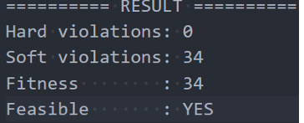
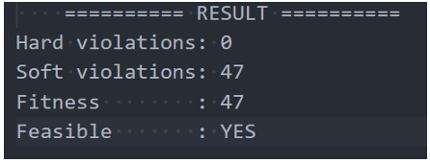
Results
Cultural Algorithm
Summary of results for all instances
Cultural algorithm evaluation on small instances using ITC-2002
Cultural algorithm evaluation on medium instances using ITC-2002

Slide 70


System Architecture
Architecture Overview
Presentation
Application
Optimization
Modern, responsive UI for configuration and visualization.
RESTful API orchestrating data validation and task queuing.
Standalone C++ engine for genetic/evolutionary computation.

Slide 71

System Architecture
Architecture Overview
Presentation Layer
Next.js Frontend
Responsive Interface: Optimized for institutional data input and schedule display.
Parameter Management: Handles constraints, room features, and student enrollments.

Slide 72

System Architecture
Architecture Overview
Application Layer
FastAPI Orchestrator
Data Validation: Pydantic models for rigorous input sanitization.
Task Delegation Offloads heavy processing to Redis queues.

Slide 73

System Architecture
Architecture Overview
Data Persistence
Relational PostgreSQL
Transactional Integrity: Ensures consistency across complex table relationships.
Structured Storage: Houses events, constraints, and student enrollments.

Slide 74
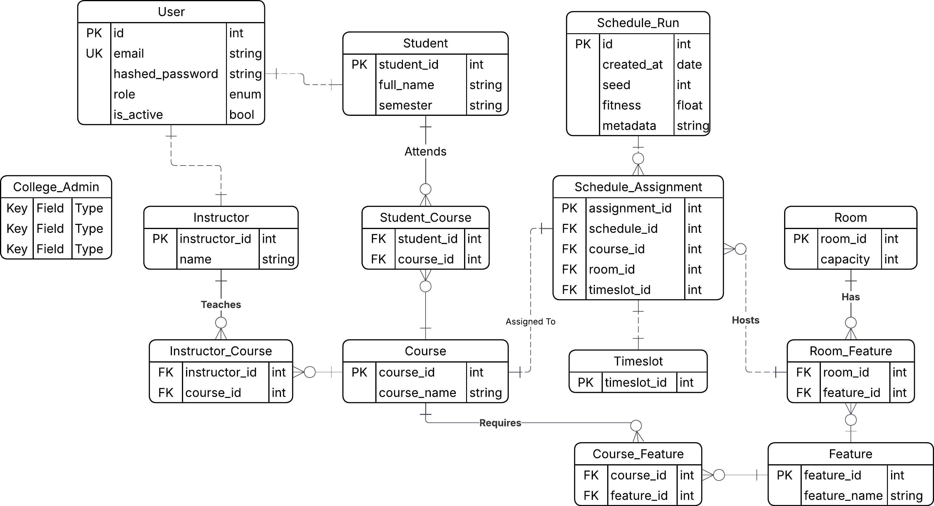
System Architecture
ERD

Slide 75
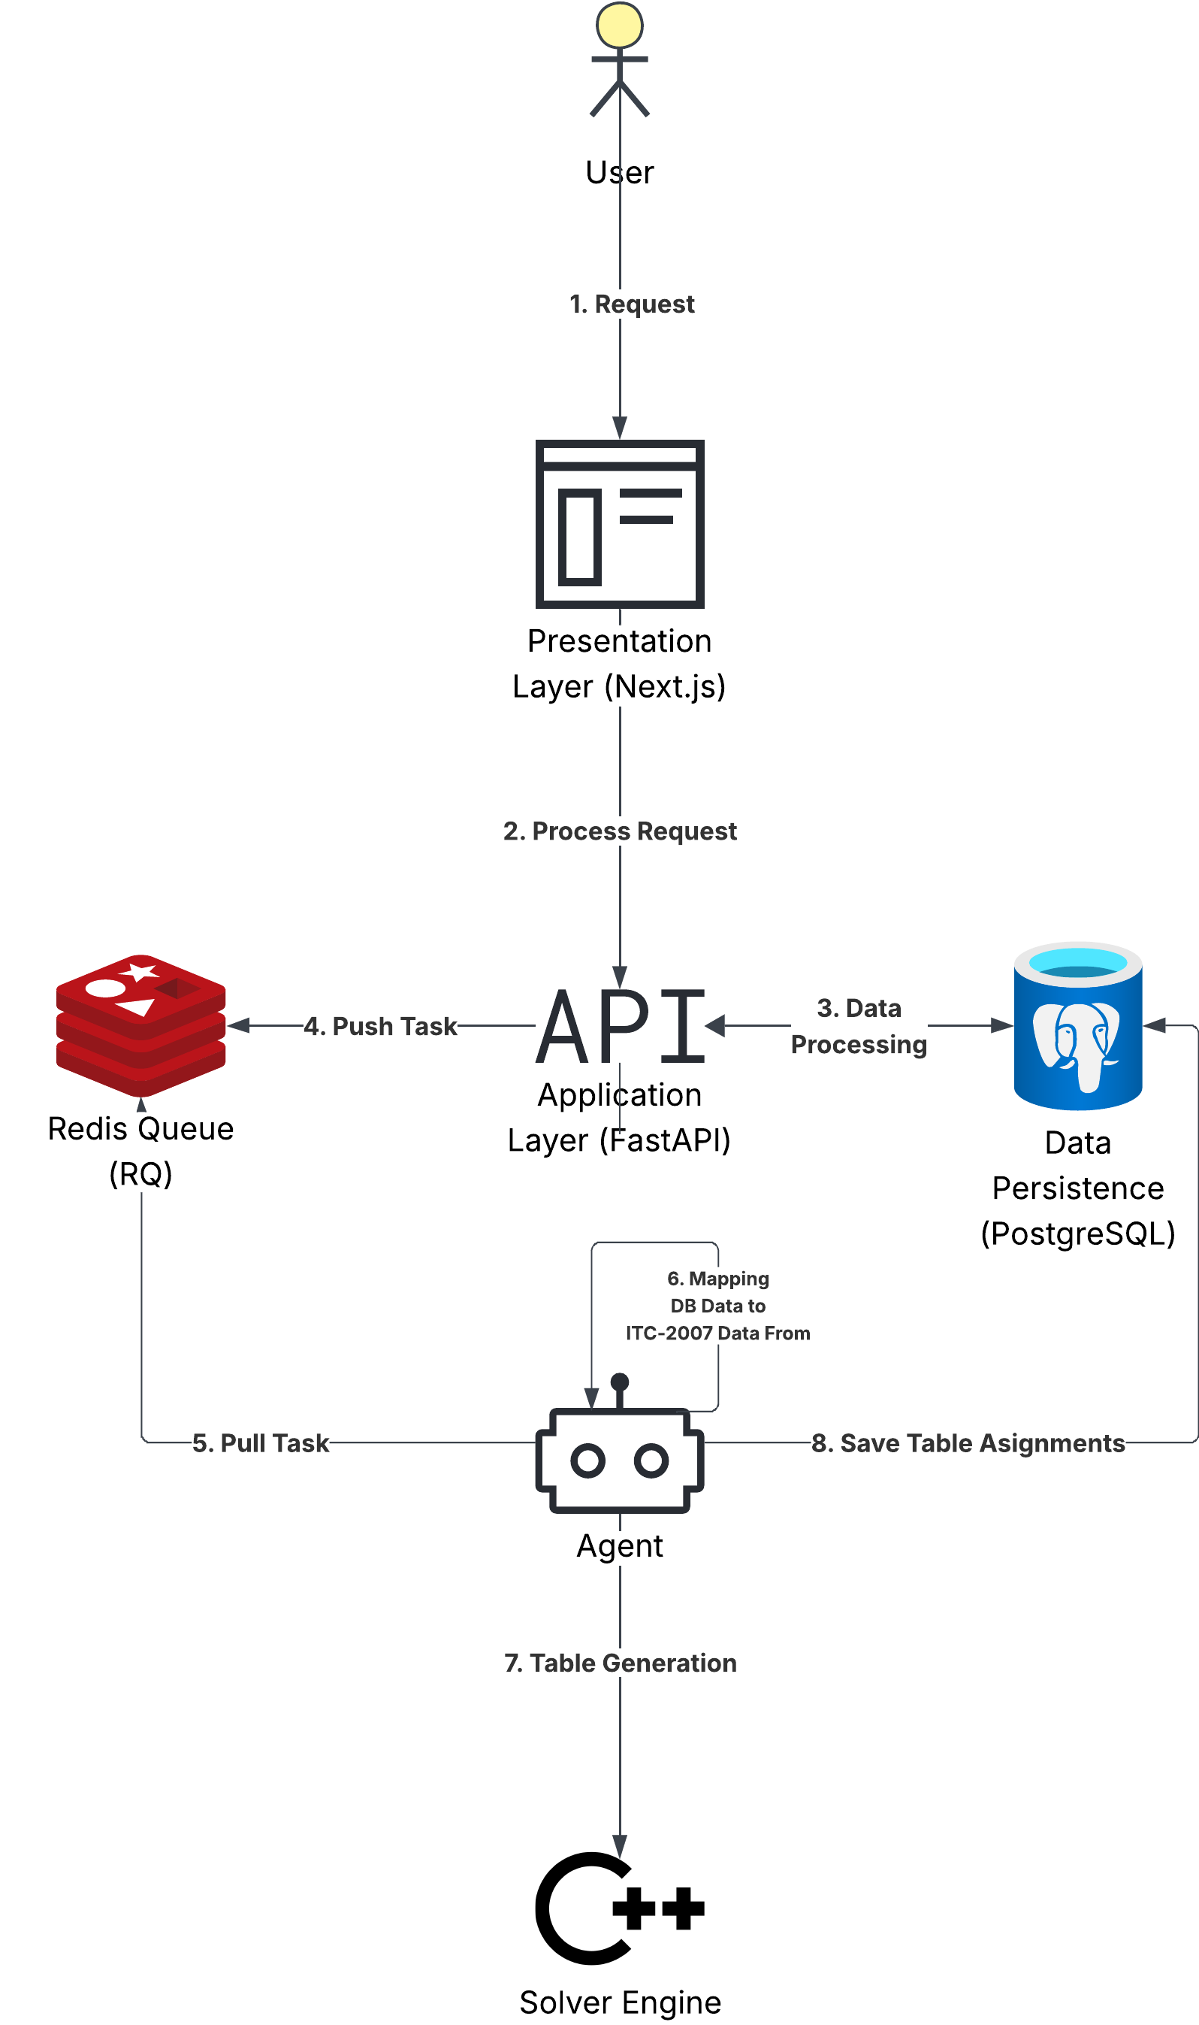
System Architecture
System architecture diagram:

Slide 76


System Architecture
Asynchronous Management
Redis Queue (RQ)
Worker Implementation
Acts as the buffer between the API and the solver. Prevents main thread blocking during intensive optimization.
Independent workers consume jobs from the queue, triggering the C++ executor and managing its lifecycle.

Slide 77
Conclusion and Future Work
Conclusion
Research Contributions
Developed a comprehensive framework for solving the University Course Timetabling Problem (UCTP).
Implemented and evaluated multiple advanced metaheuristics:
Memetic Algorithm (MA)
Cultural Algorithm (CA)
Hybrid Genetic Algorithm with Tabu Search (HGATS)
Guided Search NSGA-II (GSNSGA-II)
Designed a high-performance C++ optimization engine with efficient search and evaluation mechanisms.

Slide 78
Conclusion and Future Work
Key Achievements:
Experimental Results
Achieved 100% feasibility across benchmark instances (zero hard-constraint violations).
Significantly reduced soft-constraint penalties.
Validated on internationally recognized:
ITC-2002 Dataset
ITC-2007 Dataset
Extended the problem from a Single-Objective formulation to a Multi-Objective Optimization Problem (MOOP).

Slide 79
Conclusion and Future Work
Future Work
Explicit Lecturer Modeling and Faculty Preferences.
Distributed Multi-Node Processing for Large-Scale Universities.
Advanced Analytics Dashboards for:
Room Utilization
Resource Allocation
Scheduling Insights

Slide 80

Thanks a million!! ☺
Questions .. ?
Comments .. ?
Presented by:
Ahmed Ragab Desouki Mohamed
Ahmed Amr Moustafa Fouad
Ahmed Mohamed Mohamed Saleh
Ahmed Mohamed Mahmoud Ibrahim
Asem Hamed Elsayed Mahmoud
Abdelrahaman Hany Hegazy Saber

